Slide 1

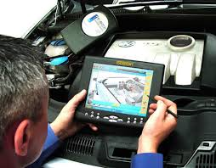
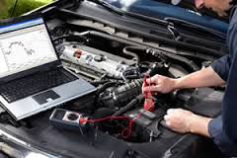
Paper 1 - Theory
2014
A car company has decided to develop an expert system to help mechanics with their diagnoses of car faults.
(a) Describe steps required in the analysis and design of such a system.
Current system is observed:
Mechanics/potential users interviewed
Mechanics/potential users given questionnaires
Gather information from manufacturers/about current system/from experts
Existing documents examined
Inputs, outputs and processing of the current system determined
Problems with current system identified
User and information requirements identified
System specification decided
Knowledge base designed
Inference engine designed
Rules base designed
User interface designed
Hardware chosen

Slide 2
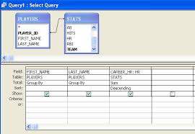
Paper 1 - Theory
2014
19 Paula, a systems analyst, has created a computer system to keep records in a small pharmacy.
Identify three types of test data she could use to test the system.
Normal data, Abnormal data, Extreme data & Live data
b) The system will now be implemented.
Apart from speed of implementation, describe one benefit and one drawback of using the direct changeover method for the pharmacy.
Benefit – cheaper as only one set of workers needed
Drawback – have no backup system to fall back on
The pharmacist will be able to search for details of medicines using the database software.
Describe four other database features which will help the pharmacist.
Pharmacist can save queries about details of medicines
Pharmacist can create reports of stock
Pharmacist can create charts of sales
Pharmacist can sort medicine records
Pharmacist can enter data using Input forms
Pharmacist can derive costs of re-ordering medicines using calculated fields
Description of how two tables could be linked by the pharmacist

Slide 3


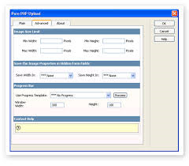
Paper 1 - Theory
2014
A car company has decided to develop an expert system to help mechanics with their diagnoses of car faults.
Describe steps required in the analysis and design of such a system.
Current system is observed:
Mechanics/potential users interviewed
Mechanics/potential users given questionnaires
Gather information from manufacturers/about current system/from experts
Existing documents examined
Inputs, outputs and processing of the current system determined
Problems with current system identified
User and information requirements identified
System specification decided
Knowledge base designed
Inference engine designed
Rules base designed
User interface designed
Hardware chosen

Slide 4
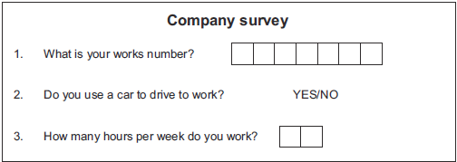
Paper 1 - Theory
2014
Students are using questionnaires to find information about workers at a company. They are going to construct a database to store the results.
Each worker at the company has an individual works number which starts with a letter and has 6 digits e.g. A123456.
Below is part of a questionnaire which some students have created to collect the results.
(a) Name a suitable data type for the answer to:
Question 1: Alphanumeric/text
Question 2: Boolean/logical
Question 3: Numeric/integer
(b)Name the validation check which would be most suitable to ensure that data entered for question 1 of the questionnaire is acceptable.
Format/length

Slide 5
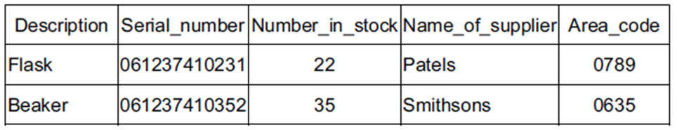
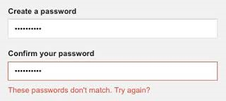
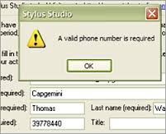
Paper 1 - Theory
2014
The chemistry department in a school keeps its stock records on computer. The stock for any item is not allowed to fall below 10 or go above 100.
Here are examples of records from the suggested database.
Name two ways in which the data could be verified.
Visual verification
Double data entry
For each of these validation checks write down the field that would be best suited to it.
You must name three different fields.
Range: Number_in_Stock
Length: Area_code
Check digit: Serial_number

Slide 6
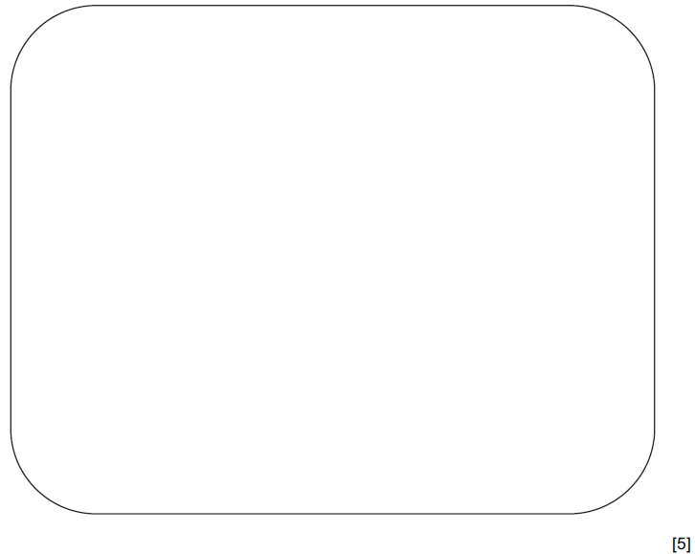
Paper 1 - Theory
2014
A library has decided to update its computer system. The details of each book are typed into a screen input form.
(a) Design a suitable screen input form for inputting the details of one book. The form must have
appropriate spacing for each field, and navigation aids.
Book Name
Author
Genre
Dropdown Menu
Fiction
Check Box (Boolean)
<Back
>FW
Navigation Aids
Save

Slide 7
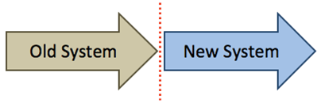
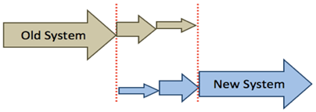
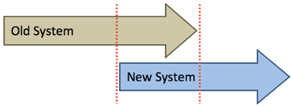
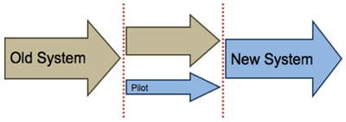
Paper 1 - Theory
2014
The library wants to include the new computerised borrowing system on its website.
Borrowers will be able to reserve or renew books using the Internet.
The new system will be implemented.
Describe three different ways in which the system could be implemented.
Parallel running is running the old and new system together
Direct changeover is stopping the old system and starting the new one immediately
Phased implementation – new system is implemented part by part
Pilot running – system is implemented in one branch/office (at a time)

Slide 8
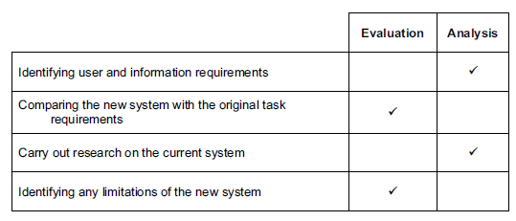


Paper 1 - Theory
2014
Tick whether the following tasks are carried out in the Evaluation or Analysis phase of the systems life cycle.

Slide 9
Paper 1 - Theory
2014
A systems analyst has designed a new computer system for the payroll of a large organisation.
The system needs to be tested.
Using examples of workers pay, which must not be lower than $200 and no more than $800, explain what is meant by normal test data, abnormal test data and extreme test data.
Normal data – data within a (given) range/appropriate for that data type [1]
Example – any wage between $200 and $800 [1]
Abnormal data – data outside the range/of the wrong data type [1]
Example – any wage less than $200 or greater than $800 or text such as “two hundred” [1]
Extreme data – data on the boundaries of the range [1]
Example – $200 or $800

Slide 10

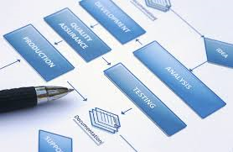

Paper 1 - Theory
2014
The systems analyst produces documentation for the system.
Give four reasons why both user and technical documentation are needed.
Technical documentation has to be produced for systems analysts/programmers
Technical documentation to know how to improve/update the system
Technical documentation to know how to repair system
Technical documentation to know how to maintain the system
User documentation so that the user can understand the system
User documentation so that the user can learn/knows how to operate/use/access the system
User documentation so that the user can overcome problems/errors

Slide 11
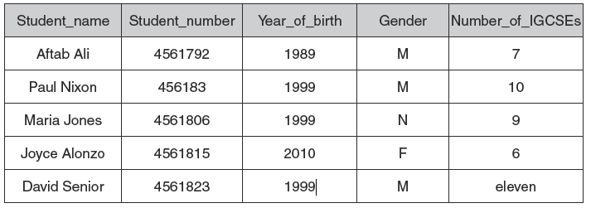
Paper 1 - Theory
2014
Here is part of a database of students born between 1st January 1999 and 31st December 1999. It shows the number of IGCSEs each student is taking next year. No student is allowed to take more than 10 IGCSEs. Each student has a seven digit Student_number.
Some of the data has been entered incorrectly.
The school secretaries who typed in the original data, verified the data to make sure they
typed it in correctly. Identify two methods of verification.
Visual verification/visually comparing data entered with original
Double data entry/entering data twice and the computer compares them
For each field, name a different validation check which would have prevented the errors in the following fields.
Range (check)/lookup (check)
(Invalid) character (check)/type (check)
Length (check)

Slide 12


Paper 1 - Theory
2014
Johann Schmidt owns several book shops. He wants to keep details of each book on a computer database.
He needs to collect data about each of his books on paper.
Describe five features of a well-designed paper based data capture form.
Adequate space for response/individual character boxes
Fonts/font size should be easy to read
Instructions how to complete form/clearly labelled field names
Logical order of questions
Questions spaced out/group relevant fields together
Not too much text
Sensible colour scheme
Use of tick boxes
Strikethroughs
Appropriate white space/fills the page

Slide 13

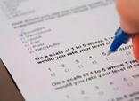


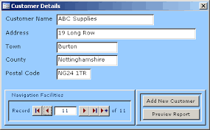
Paper 1 - Theory
2014
The owner of a shop wants a new computer system to store the records of all the stock and customers. The systems analyst will need to find out how the existing system works.
Describe, in detail, two out of the four possible ways she could find out this information.
Interview users of the existing system
Asking questions about the system face to face/in person
Distribute questionnaires to users of the existing system
Asking questions about the system in hard copy form
Observation of the existing system/workers in action
To see all aspects of the system/whole overview to see how system works
Examining documents about the current system
To see inputs and outputs to the system
B) After analysing the existing system, the systems analyst will design a database.
Identify four items that the systems analyst will need to design for the database.
Data capture forms
Screen layouts
Report layout
Screen displays
Validation routines
Data/file structures

Slide 14


Paper 1 - Theory
2014
After the system is designed, it will be developed, then implemented.
Name two methods, other than direct changeover, that could be used to implement the
system and give an advantage for each method compared to direct changeover.
Parallel running
There is always the old system to fall back on in the event of the new system failing
Training can be gradual
Phased implementation
You still have most of old system to fall back on/training can be gradual
Pilot running
Only one branch is affected if new system fails/other branches can learn from the branch’s experiences

Slide 15
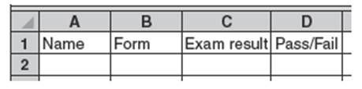
Paper 1 - Theory
2014
The English teacher stores details of her students’ exam scores in a spreadsheet. The exam is marked out of 80 and the results are typed into the Exam result column.
The teacher wants to use a validation check which only allows numbers between 0 and 80 to be typed in. What is the name of this type of validation check? Range check
She types in the following exam results to test that the validation works:
0, 25, 80 and 87.
Using the data above write down one example of:
(i) normal data
0, 25 or 80.
(ii) extreme data
0 or 80
(iii) abnormal data
87

Slide 16
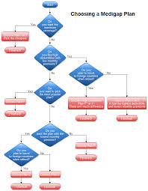

Paper 1 - Theory
2014
When the system was implemented the systems analyst gave some documentation to the sports club owner.
Name three different items found in the user documentation. | Name three different items in the technical documentation which are not present in the user documentation
How to load software/ run software/install software How to save a file How to search, sort, print How to add records/edit/delete Purpose of the system Input format or example Output format or example Hardware requirements Software requirements Sample runs/test runs Limitations of the system Troubleshooting guide/contact details/help line/FAQs Error messages/handling Tutorials | Program coding/listing Name of program language System flowchart Program flowchart/algorithm List of variables File structure Known bugs Validation routines Purpose of the program

